Slide 1


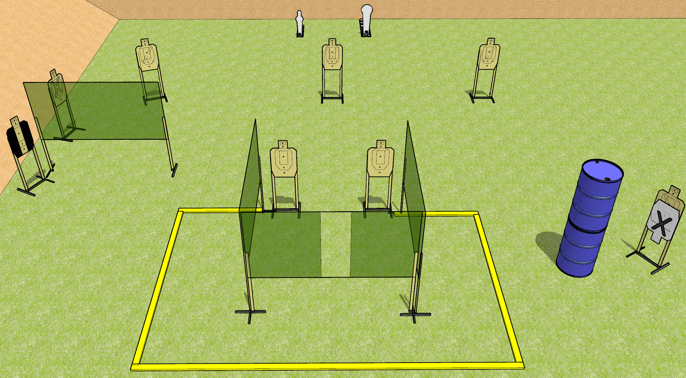
 | Dothan Gun Club – USPSA Match Welcome! Course Designer : Drew Coleman
START POSITION : Standing inside shooting area with heels against rear fault line, wrists below belt
GUN READY CONDITION : Pistol loaded and holstered. PCC loaded, buttstock on belt, safety on, pointed down range. |  | SCORING: Comstock, 18 rounds TARGETS: 8 paper, 2 Steel SCORED HITS: Best 2 on paper, steel until down START-STOP: Audible, last shot RULES:
STAGE PROCEDURE: Engage targets as they become available from within the fault lines.

Slide 2
Welcome!
Written Stage Briefing
Welcome is an 18 round, 90 point, Comstock Medium Course. There are eight USPSA targets, one Colt Popper, and one mini-popper. The best two hits on paper will score, and steel must fall to score. The start signal is audible.
Handgun start position is standing inside the shooting area with heels touching the rear fault line. Handgun is loaded and holstered.
PCC start position is standing inside the shooting area with heels touching the rear fault line. Loaded carbine is held with both hands, buttstock on belt, safety on, pointed downrange.
Upon start signal, engage targets as they become available from within the fault lines.

